Slide 1

VIDEO GAMES SALES ANALYSIS USING SQL AND ADVANCED EXCEL Presented By: Tanwita Kar

Slide 2

Introduction
In 1948 Alan Turing and David Champernowne had developed the first video game
Over 831000 video games are available on Steam, GOG, Xbox, Nintendo, Ubisoft etc.
In 2023, video games industry has reached the revenue of US$249.60bn.
It is expected to grow at an annual rate of 9.32% between 2023 and 2028
Projected market volume of US$389.70bn by 2028

Slide 3

Case Study
The dataset comprises of 16599 rows and 11 columns
Rank wise video games are available
Name of the video games, their released year, individual genres are mentioned
Game publishers are mentioned
Video game sales in the most prominent countries, North America, Japan, European countries and other countries are mentioned
Global total sales available

Slide 4

Major Objectives
Genre-wise Analysis
To find the total global sales of each genre of video game
To find the average global sales of each individual genre of video game
To count the number of games released on “Action” genre year wise analysis
Platform wise analysis
Number of games released in each platform
Identify the top 5 platforms having highest average global sales
To retrieve the games and genres published by Nintendo
Country wise games analysis
Top 10 highest sold video games in worldwide
Average global sales of each year
To analyse “Wii Sports” selling price in different countries
In-detail analysis of Nintendo games

Slide 5

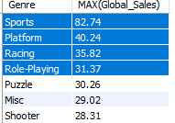
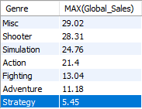

Data Analysis
Approximately $82.47 million of maximum revenue has been achieved through Sports genre
Along with this Platfrom, Racing and Role-Playing games hold top 4 positions in total global sales
Strategy games are the lowest sold category of video games
Data shows ‘Pokemon Stadium’ had significant sales over the world being Strategy games.

Slide 6

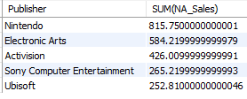
List the top 5 publishers
Nintendo has the maximum number of games with maximum total global sales in the World
Electronic Arts, Activision, Sony Computer Entertainment, Ubisoft are the top 4 game publishers having highest sales

Slide 7

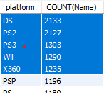
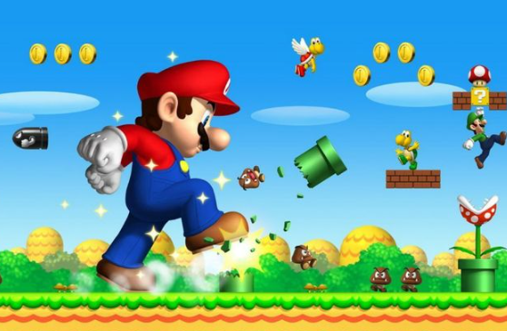

Number of games published in each platform
DS, PS2, PS3, Wii and X360 are the top 5 game publishing platforms
New Super Mario Bros. is the highest sold game published in DS platform

Slide 8
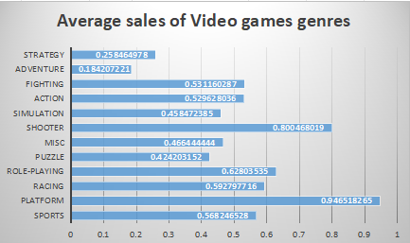
Average sales of different video games genres
Platform, shooter and role playing game categories are the most highest average sold games in the Worldwide basis

Slide 9

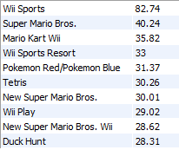
List of Top 10 games with the highest global sales
Wii Sports is the highest sold video game in the worldwide basis
Following that Super Mario Bros., Mario Kart Wii have second and third highest sales

Slide 10


Year-wise sales analysis
Analysed data shows 2001-2010 has been the most booming era in the history of video games
The Wii Sports, Mario Kart Wii, Wii Sports Resort can be
identified as one of the most significantly highest selling
games

Slide 11

Findings
Nintendo games has been one of the highest selling video games publisher
‘Action’ genre is the most favourite in the worldwide basis in gaming industry
However, Platform, shooter and role playing games are equally enjoyed by customers according to the average Global sales report
Wii Sports, Mario Kart are the most popular series having highest number of global sales in the worldwide basis
In between 2001-2010 video games sales had increased because of huge number of Action games release that time

